Slide 1
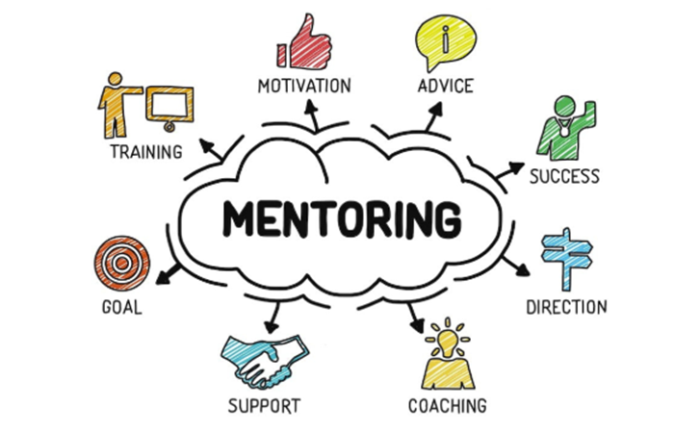
FPSA Mentor Circle Training

Slide 2
Mentor Circle Value to FPSA
Added value for members. Another great reason to join FPSA.
Providing FPSA members with another resource to obtain further education & professional development.

Slide 3
FPSA Mentor Circle Purpose
Providing ALL FPSA members an opportunity to become a mentor, or to work with a mentor, in order to nurture personal and professional growth.
Offering Mentors a Mentor Training program & 1x1 coaching with a Mentor Liaison to develop / enhance mentoring skills.
Delivering individual and small group sessions where Mentees can ask questions, share ideas and experiences, enhance relationships and explore new connections.

Slide 4
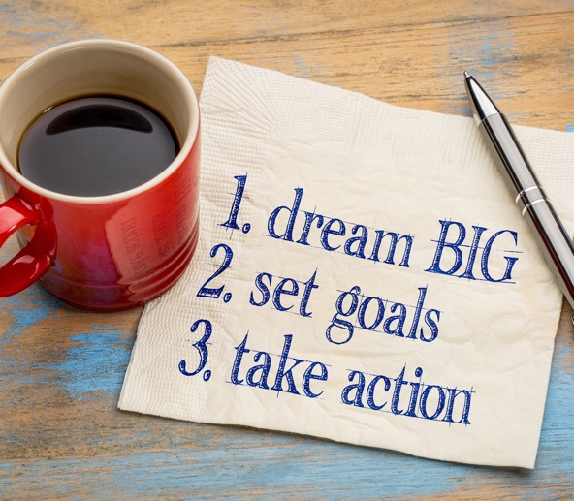
Agenda
Mentoring Relationships
Goals and Scope
Mentor’s Role
Qualities of Effective Mentors
Mentoring Skills
Communication Skills
Building Trust and Rapport
Empathy
Vulnerability
Next Steps

Slide 5
What is a Mentor?
A Mentor is an experienced and trusted coach.
A mentoring relationship is when someone forms a supportive, coaching relationship with someone else.

Slide 6
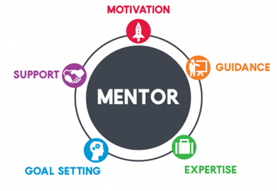
How does a Mentor Circle work?
A Mentor Circle is a small group of professionals that meet on a regular basis for an agreed upon length of time in an interactive virtual forum.

Slide 7
What is a Mentor Circle?
Mentor Circles can provide suggestions for career development, access to subject matter experts, and ideas on how to resolve difficult situations
Mentor Circles are where you ask for and share advice and resources when it makes sense for you
Virtual Mentor Circles transcend groups and organizational boundaries
Virtual Mentor Circles are about the benefits and rewards that everyone in the network receives — there is a high degree of reciprocity
Virtual Mentor Circles are permeable and sometimes defy logic — competitors, peers, and virtual communities can be mentors

Slide 8
How to Mentor a Group
Group mentors guide mentees on how to accomplish their goals, help to troubleshoot and solve work-related problems, and provide structure in a virtual environment
Is self-directed—you ask for and share advice and resources when it makes sense for you
Focuses on the benefits and rewards that everyone in the network receives—there is a high degree of reciprocity
The relationships can be unique and sometimes defy logic—competitors, peers, and diverse roles and areas of expertise

Slide 9
FPSA Mentor Circle Program Logistics
1 Mentor + 6-10 Mentees
Matched based on a combination of factors (personality, interests, Mentor Circle goals, mentor’s strengths, network affiliation)
Virtual meetings every 4 weeks, 1- 1 ½ hours
Mentors offer support and moderate each session

Slide 10
Mentors offer…
Personal Connection
Empathy
Active Listening
Validation
Acceptance without judgement
Encouragement with healthy lifestyle choices (work/life balance)
Modelling positive self-talk
Foster motivation, hope

Slide 11
Goals of Mentoring
We hope that Mentees…
Experience a sense of connection, support, empathy
Develop strategies to effectively manage their careers
Develop strategies to effectively manage their work/life balance
Receive validation and unconditional acceptance from their peers

Slide 12
“It’s the Mentee’s Journey”
“I think mentors are important and I don’t think anybody makes it in the world without some form of mentorship. Nobody makes it alone. Nobody has made it alone. And we are all mentors to people even when we don’t know it.”- Oprah Winfrey A Mentor guides mentees for a brief part of their journey.
Goal is to provide support, validation, and empathy through mentoring relationship + Help mentees develop
useful skills and strategies

Slide 13
Support Network
How is a mentoring relationship different from other support networks?
Empathic ear
Career support
Practical strategies
Resources
Train
Hold accountable
Provide direct feedback
Goal setting
Peer Mentor
Supervisor, Manager
Love, intimacy
Fun, casual humor
Feedback
Two-way relationship
Physical affection (hugs, touch)
Conflict resolution
Content knowledge
Family, Friends
Human Resources

Slide 14
What Makes a Good Mentor?
Think about someone who has been a mentor to you.
What qualities or skills made them an effective mentor?
Why was their approach effective?
Think about their words, their listening skills, their tone of voice, their responses to you.
Brief (2-3 minutes) break to answer the above and share with others on the call.

Slide 15
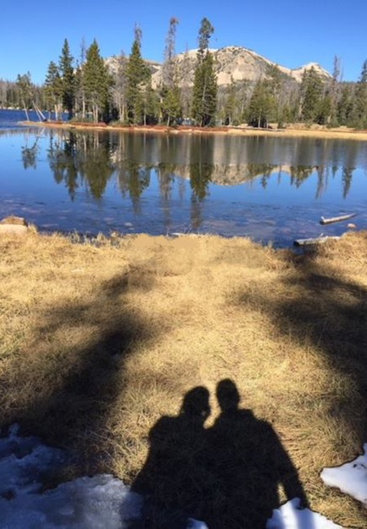
Mentoring Skills
Verbal communication skills
Open-ended questions
Active listening
Reflection
Summarizing
Non-verbal communication skills
Empathy
Mirroring
Trust and Rapport
Overcome communication blocks

Slide 16
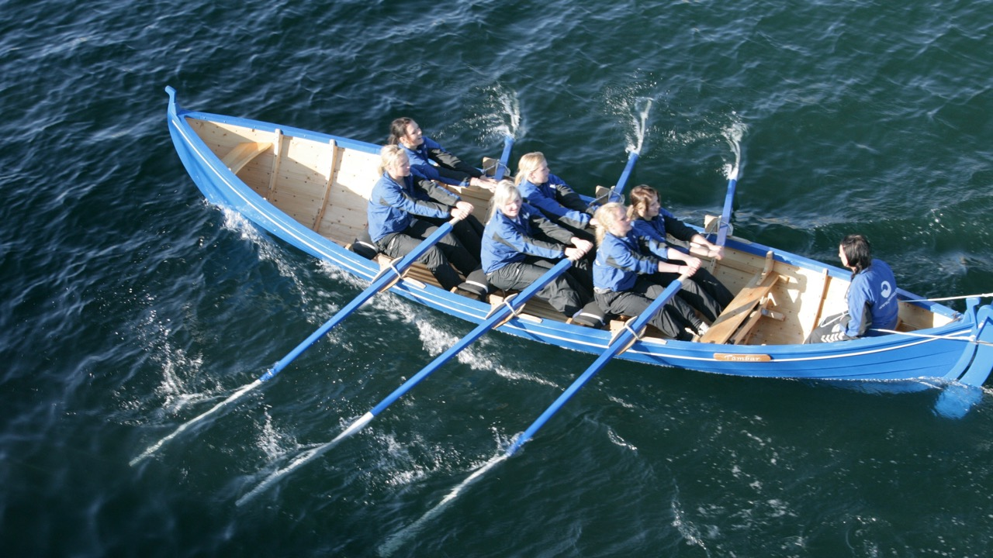
Communication Skills: OARS Model
The OARS Model can be used to remember key communication skills.
Does not have to be used in this order
O = Open-ended questions
A = Active listening
R = Reflection
S = Summarize
This Photo by Unknown Author is licensed under CC BY-SA

Slide 17
OARS - Open-Ended Questions
Helps the mentees explore events, feelings, and options for action
Encourages the mentees to do most of the talking
Begin with words such as “How”, “What”, or phrases such as “Tell me more about…”
Avoid questions beginning with “why” – can make people feel defensive

Slide 18
OARS - Open-Ended Question Examples
How do you feel about that?
Would you like to talk about…?
Can you tell me more about…?
What have you tried in the past?
What have you thought of doing?
How do you see things changing?
What is one thing you think would be helpful to start with?
Notes:
Ask the volunteers: What are some other open ended questions?

Slide 19
OARS – Active Listening Skills
Pay attention
Ask questions to clarify as needed
“Just to make sure I understand…”
Affirming presence
Give the Mentee the message “I see you and hear you”
Your tone of voice and using their name can be affirming
Validate their feelings “It’s normal and okay to feel this way”
Notes:
Use your active listening skills to show that you are listening.

Slide 20
OARS – Reflective Listening
Reflect back what you think the mentee is saying, or what you observe. For example:
It sounds like…[paraphrase] Is that right?
I hear you saying that…[paraphrase] Is that how you’re feeling?
Helps ensure that you understand what the mentee is saying
Mentee can hear what they have said, clarify, feel understood

Slide 21
OARS - Summarizing
Summarizing is a good way to organize thoughts and pull together key points.
Useful if a mentee or the group gets off track, when transitioning between topics, or at the end of a meeting.
End with an invitation for mentee to respond
What did I miss? What else would be helpful today? What other questions do you have?
For example:
Today, we’ve talked about…
So you’ve mentioned…

Slide 22
Virtual Non-verbal Communication
Communication is more than just words – even virtually. What else are you saying?
Body Language
Attending Behaviors
Your Voice
Facial expression
Eye contact
Posture
Nodding
Smiling
No fidgeting or checking email
Tone of Voice
Speed of speech

Slide 23
Practice Your Communication Skills
During conversations over the next 2 weeks work on your communication skills use OARS
Use the OARS model to listen to what someone is telling you and ask questions to understand
O = Open-ended questions
A = Active listening
R = Reflection
S = Summarize

Slide 24
Exercise Debrief
Communicating is a skill! Growth is possible with self-reflection, being open to discomfort and learning, and feedback. It takes practice!
Self-reflection:
What aspect of the exercise was difficult for you? What was the exercise like? What did you learn?
When appropriate ask for feedback:
Body language, attending behavior, and voice
Was the OARS model used? What worked? What didn’t?
Notes:
The object of this activity is to increase your awareness of your communication skills.

Slide 25
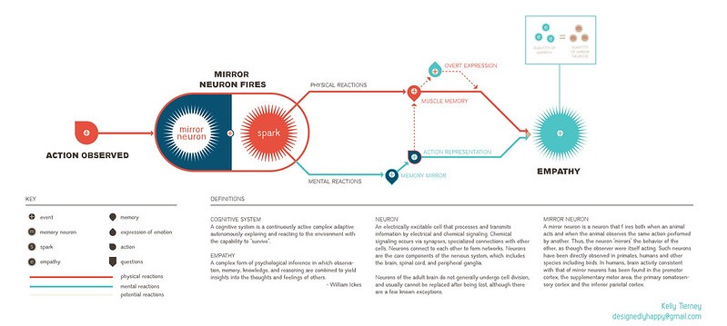
Empathy for the rest of us
Empathy for engineers ☺
Brene Brown clip on Empathy (2:54)
https://www.youtube.com/watch?v=1Evwgu369Jwhttps://www.youtube.com/watch?v=1Evwgu369Jw

Slide 26
Vulnerability is Key to Empathy
“Empathy is a choice, and it’s a vulnerable choice. In order to connect with you, I have to connect with something in myself that knows that feeling.”
The Mentee shows vulnerability by opening up to their Mentor Circle. A Mentor shows vulnerability by being comfortable in understanding the Mentee and feeling empathy for them.
This Photo by Unknown Author is licensed under CC BY-SA-NC
Notes:
Mentee is in a more vulnerable position in the mentoring relationship – when sharing and expressing feelings, when trying new strategies, when setting goals and failing.

Slide 27
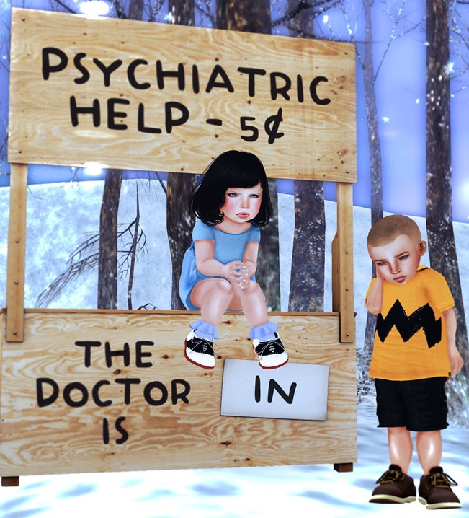
Empathy and Communication Blocks
Dismissing - “You’ll be fine”, “That’s not a big deal”
Playing the expert - “I know exactly what you mean”
Preaching - “You should…”, “It is your responsibility to…”
Rationalizing or ‘explaining away’ - “You don’t really mean that”
Assumptions – “You must be so excited!”
Giving advice, fixing – “Why don’t you just do this?”
Notes:
Everyone at some point has engaged in “Communication Blocks”. These are typical things that people sometime do that they don’t realize hinder the conversation.

Slide 28
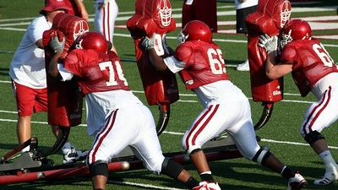
Empathy and Communication Blocks
How do these patterns block empathy and vulnerability?
How would these ‘blocks’ make a mentee feel?
How do these ‘blocks’ serve the mentor?
Notes:
Everyone at some point has engaged in “Communication Blocks”. These are typical things that people sometime do that they don’t realize hinder the conversation.

Slide 29
Practicing Empathy and Vulnerability
Personal Visualization Exercise
Think about a time where you experienced a personal struggle.
How did you feel physically? How did you feel emotionally? What were your thoughts or inner dialogue (self-talk) like?

Slide 30
Building Trust and Rapport
What are some things you can do to build trust and rapport?
Break the ice with small talk
Share some personal information about yourself
Find some shared experiences
Good communication skills (OARS, non-verbal)
Listen with an aim of understanding
Show empathy
Use humor appropriately. Laughing together can create harmony & connection.
Be patient – trust takes time!

Slide 31
Self-Disclosure
Self-disclosure is when you share information about yourself or your own experiences with your mentees
One way to build trust and rapport, show empathy
TIPS
Keep it brief… focus on the mentees
Use it only when it is helpful
Remember that not everyone’s experiences are the same
Say something like “Everyones experiences are unique and my situation isn’t exactly the same as yours, but I think I can relate to that struggle…”

Slide 32
Make a smart investment - the more energy you put into into the program the more lucrative the rewards
Remember…
Be mindful of the opportunities and limitations of a mentor’s role.
Practice good communication skills (OARS)
Listen to understand
Choose empathy
Accept without judgement
Avoid assumptions
Self-reflect regularly
Be yourself!

Slide 33
Mentor Liaison
Mentoring meeting follow-up
Email Mentor Liaison within 3 days with topic discussed, attendees and any questions or concerns. This can be very brief.
One-on-One meetings
Scheduled after your first 1-3 mentoring meetings, or as needed. The Mentor Liaison is always available for consultation.
Ongoing training
Ongoing training and professional development sessions will be offered to address common issues or share helpful tips and/or ideas/material for sessions.
Occasionally joins Mentor Circle sessions

Slide 34
Launching Your Circle

Slide 35
First Meeting Agenda
Introductions
A bio overview
(Optional) Fun question of your choice (i.e. favorite movie, food, book)
Personal hobbies/interests/family
What they want to get out of the Mentoring Circle
Ground Rules development
Schedule – day, time and duration of monthly meeting
Attendance requirements
Confidentiality and personal respect
Role assignment for each meeting: Discussion leader, scribe/timekeeper (mentor for the first session),
Future Topic Discussion and Selection with assigned leader
Next meeting date and time reminder
Mentor Circle Evaluation

Slide 36
Mentor Circle Agenda
Attendance and Topic Review
Topic discussion
Review next meeting leader, topic, scribe/timekeeper, date and time
Mentor Circle Evaluation

Slide 37
Potential Topics for Mentor Circle Discussion
Analysis Leading Others
Communication Styles Negotiation
Community Involvement Networking
Courageous Conversations Presentation Skills
Cultural Differences Problem Solving
Decision Making Professional Certifications
Feedback (Giving & Receiving) Project Management
Gender Differences Relationship Mgmt/Building Relationships
Generational Differences Roadblocks/How to Remove Them
Career Development/Planning Strategy
Change Management Succession Planning
Conducting Effective and Efficient Meetings Team Building
Conflict Management Time Management
Continuing Education Vision
Influencing Others Work/Life Balance
Innovation

Slide 38
Mentor Circle Evaluation
At the end of every mentor circle a 5-minute evaluation process should take place.
Three areas will be scored 1-5 ( 1 low and 5 high) by each participant, mentees first and then the mentor.
Ground Rule Compliance- Did we start and end on time? Did we follow our ground rules?
Content- Did we stay on topic? Was the content meaningful and useful to me?
Engagement- Did everyone speak and participate? Did I provide useful insights for others?
If anyone scores less than a 3 on any rating aske them to provide a suggestion to the group on how they and the group can improve for the next meeting.
Scores can be maintained from meeting to meeting if desired, or just used for guidance on ensuring that all are getting and creating value from the mentor circle.

Slide 39
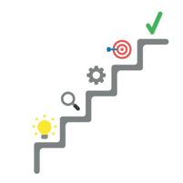
Next Steps
Match up Mentees to Mentors
See handouts:
First Mentoring Meeting Agenda
Mentor Guidelines
Mentor Circle Session Evaluation
Set your first meeting

Slide 40
Questions?

